Slide 1
Vorstellung der AG Northup & Abschlussarbeitsthemen 2025 Tracy Northup, Department of Experimental Physics

Slide 2
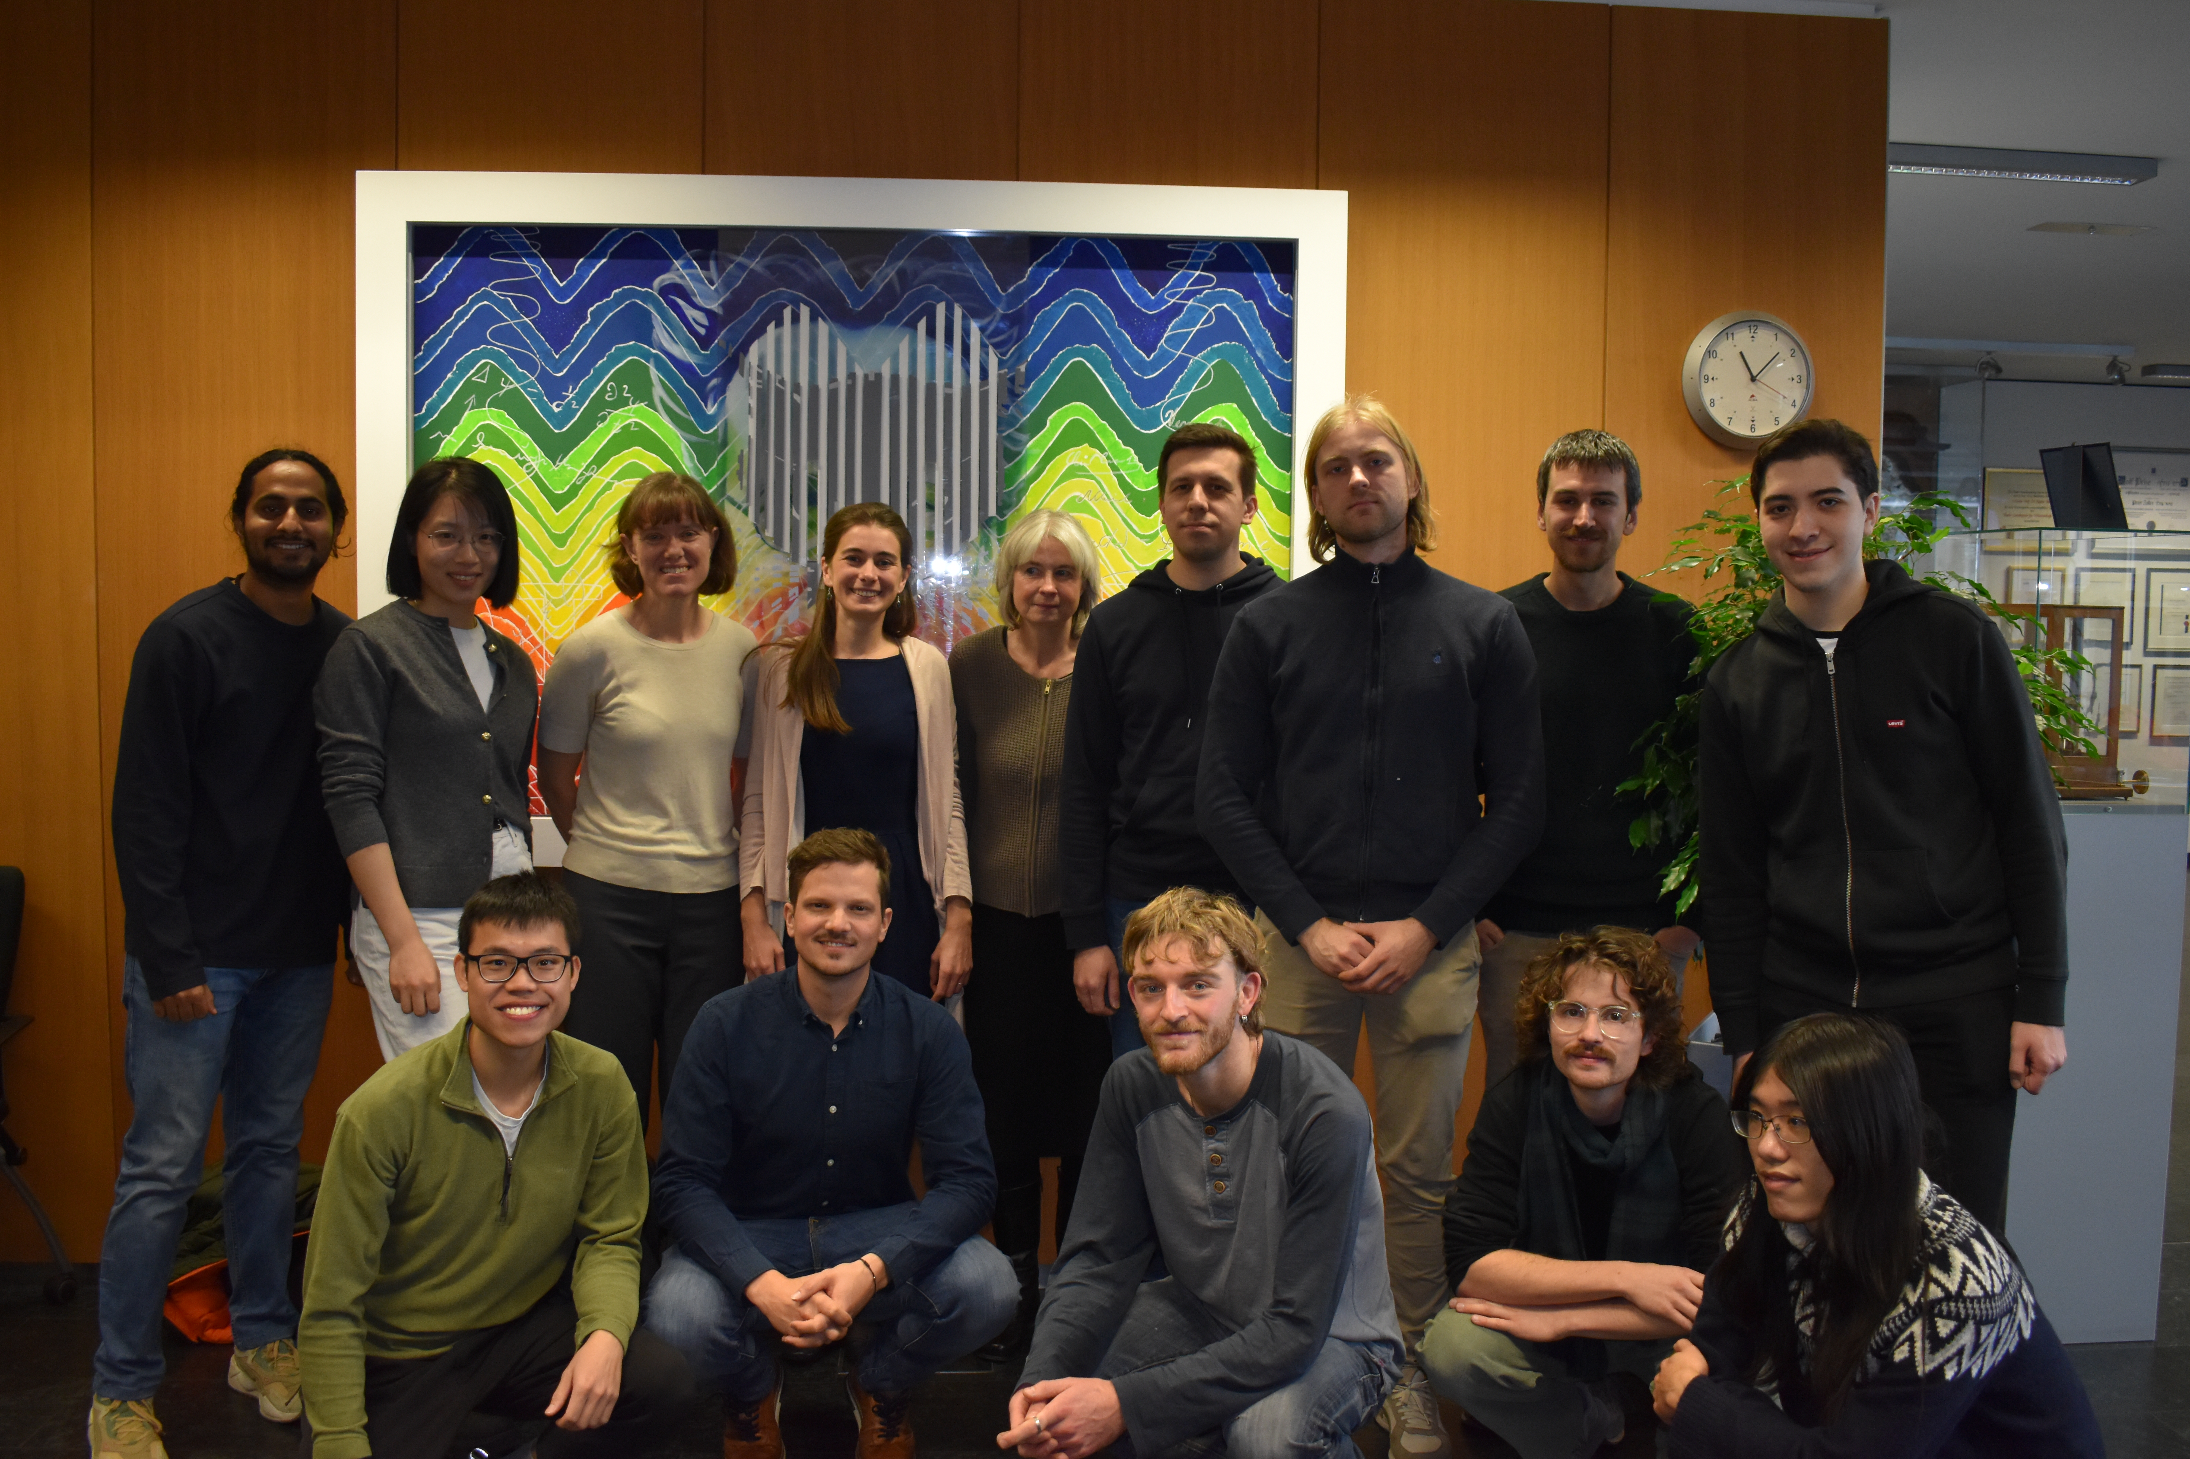
Quantum Interfaces Group
three postdocs, nine PhD students, two master’s students
quantum interfaces: how can we transfer quantum states between atoms (ions), photons, & phonons?

Slide 3
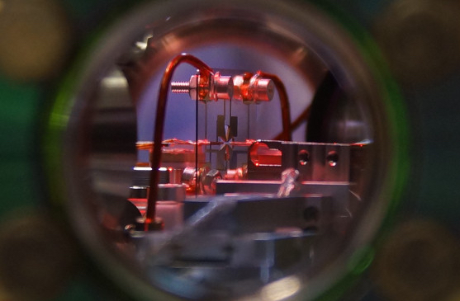
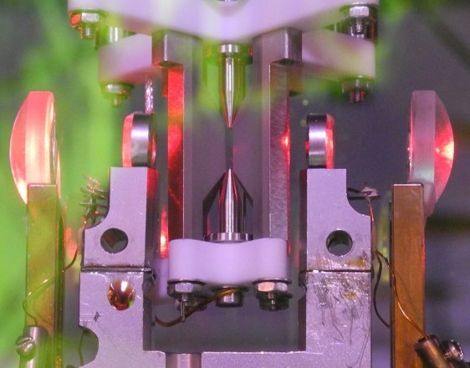
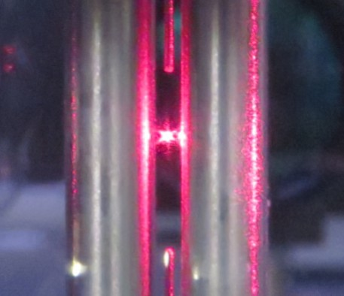
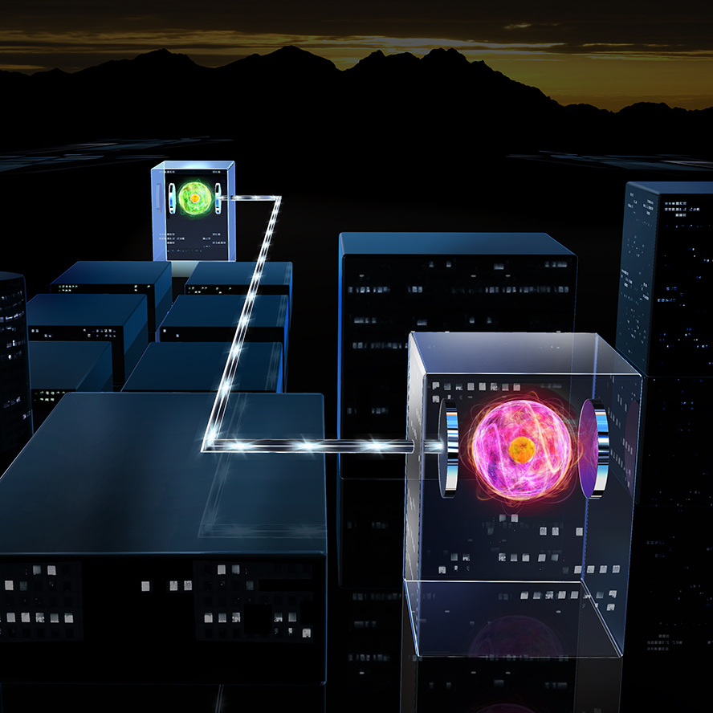
trapped ions coupled to optical cavities for quantum networks
levitated nanoparticles: towards quantum states of motion
How can we distribute quantum entanglement over long distances?
Can we prepare macroscopic quantum superpositions?

Slide 4
Recent bachelor’s thesis topics
“The attosecond optical clock network,” Matthias Dallio
“Quantum approximate optimization algorithm with a trapped ion quantum simulator,” Pavel Filippov
“Quantenlogik-Spektroskopie von hochgeladenen Ionen,” Hannah Beckmann
“Expanding the observable volume of the universe: application of squeezed light in the LIGO detector,” Regina Wieser

Slide 5
Bachelor’s thesis topics 2025
“Mechanical quantum sensing in the search for dark matter” How can mechanical systems (such as levitated nanoparticles) be used to search for dark matter? Is this a realistic approach? What are the strengths of such systems for these searches?
other topics available upon request

Slide 6
Recent master’s thesis topics
“A new control system for a quantum network node,” Riccardo Conzatti
“Towards absorption of single photons for an ion-cavity interface,” Luca Mastrangelo
“Self-homodyne position detection of a levitated silica nanoparticle,” Katharina Heidegger ÖPG Student Prize 2023!
https://www.youtube.com/watch?v=d9SJ90oxi10

