Slide 1
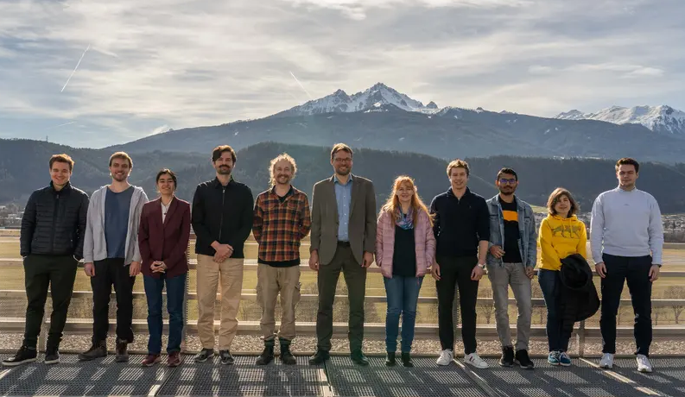
Research group Extragalactic Astrophysics
Contacts for Bachelor thesis topic requests:
Dr. Sebastian Grandis
sebastian.grandis@uibk.ac.at
Dr. Laila Linke
laila.linke@uibk.ac.at
Benjamin Csizi
benjamin.csizi@uibk.ac.at
Univ.-Prof. Dr. Tim Schrabback tim.schrabback@uibk.ac.at
Bachelor thesis topics 2025

Slide 2
Main research field: Observational cosmology
The present-day energy budget of the Universe:

Slide 3
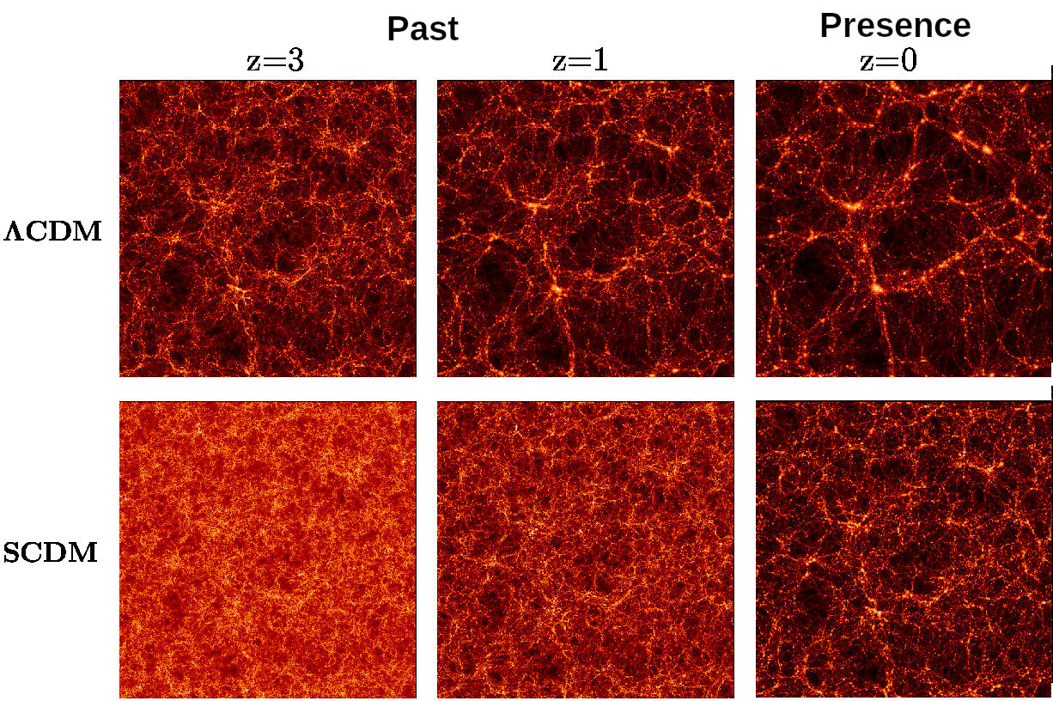
Main focus of the group: Probing cosmology via …
… the growth of structure
Dark matter distributions in cosmological simulations
Credit: Virgo Collaboration

Slide 4
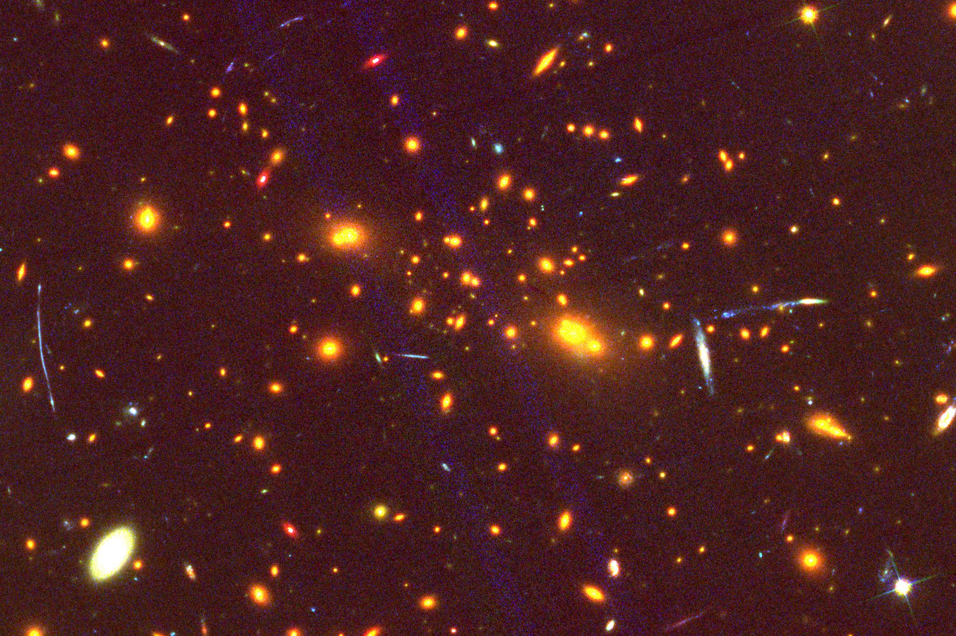
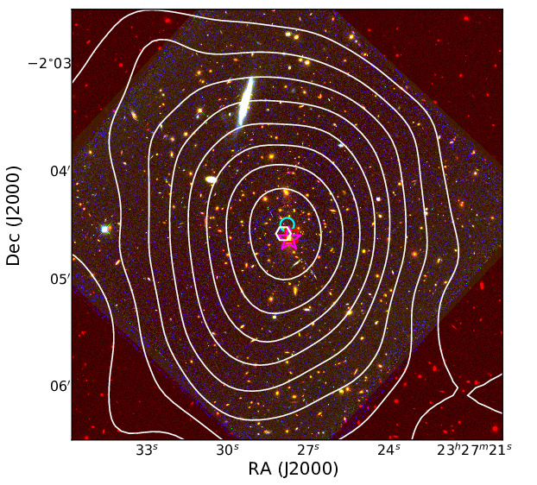
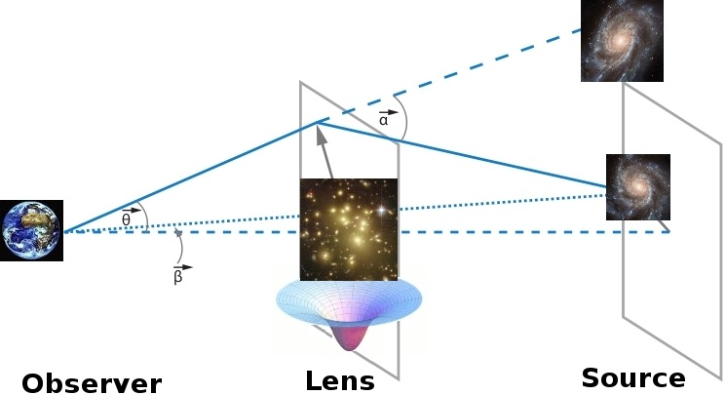
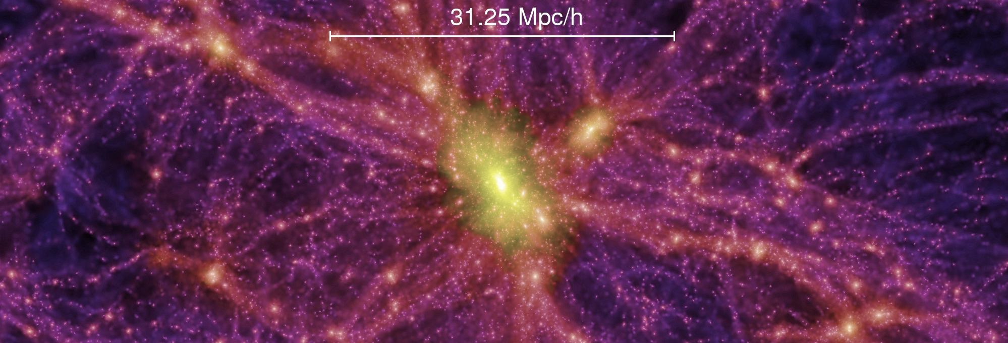
Main focus of the group: Probing cosmology via …
… the growth of structure
Galaxy cluster RCS2327-03 + lensing mass reconstruction
weak gravitational lensing
Credit: ESO / NASA / ESA / Schrabback et al. (2018b) A&A 610, A85
Credit: Treu 2011, NASA, Meteosat, C. Mc Allen
Credit: Millennium Simulation, Springel et al. (2005)

Slide 5
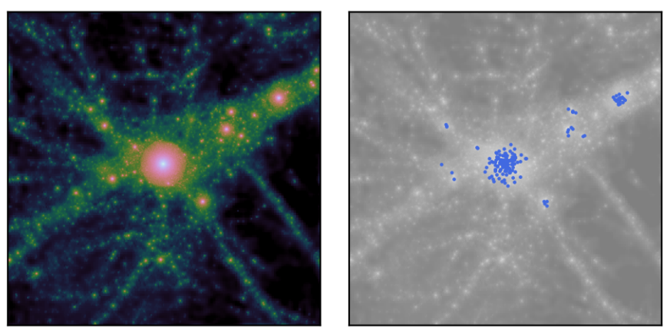
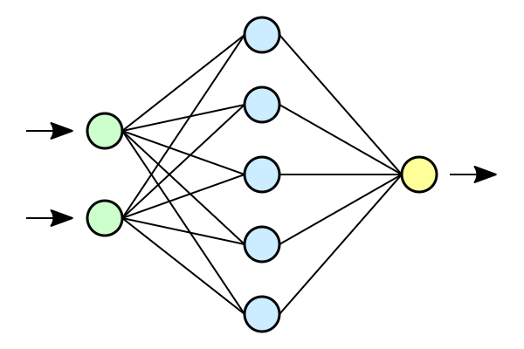
Topic 1: Accelerating models of the connection of dark matter and galaxies with AI
We can predict the spatial distribution of galaxies within the dark matter distribution and their properties with so-called halo models. But these models are computationally expensive and too slow for upcoming surveys.
Dark Matter density
Galaxies
Asgari+ (2023)
In this project you will use machine learning methods to accelerate the modelling with neural-network-based emulators.
Model parameters
Model prediction
Requirements: some python experience, experience with AI and (extragalactic) astrophysics welcome
Dake, Mysid, CC BY 1.0 via Wikimedia Commons
Grandis+21: https://arxiv.org/abs/2103.16212

Slide 6
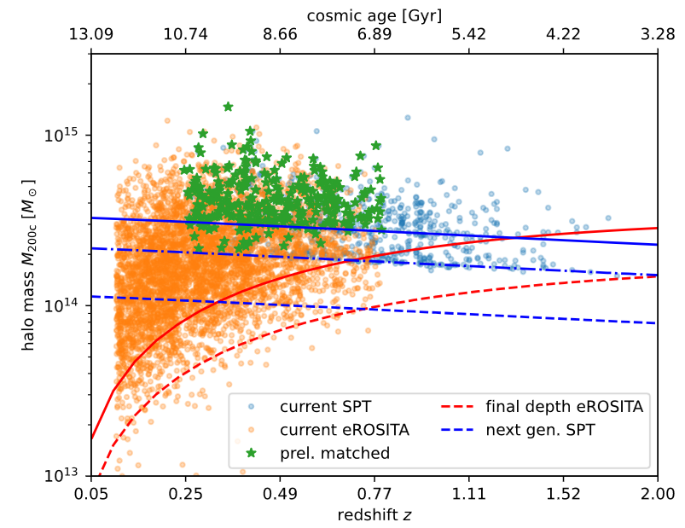
Topic 2: Comparing the cluster selection in X-ray and millimeter wavelength
Galaxy Clusters are visible via the hot (>1e7 K) plasma they contain – both in emission in X-rays, and in absorption in millimeter wavelength.
X-rays
millimeter wavelength
cluster Abell 1835 at redshift z = 0.25, viewed – from left to right – in X-ray emission,
optical light, and sub-millimeter wavelengt Allen+(2011, Fig. 7)
In this project you will use Bayesian population modelling, a generative AI algorithm used for inference
Requirements: some python experience, experience with AI, (extragalactic) astrophysics, and statistical inference welcome
Source: S. Grandis
Grandis+21: https://arxiv.org/abs/2103.16212

Slide 7
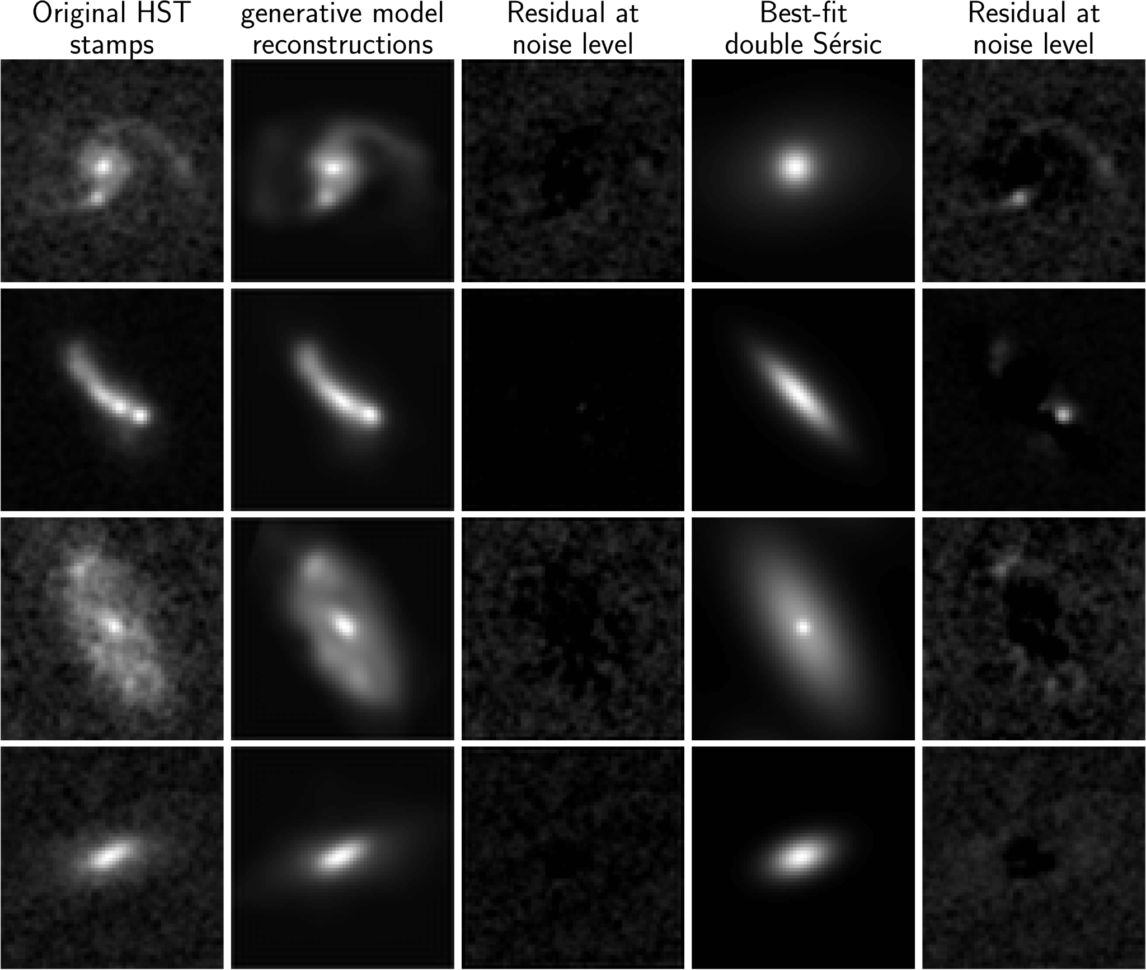
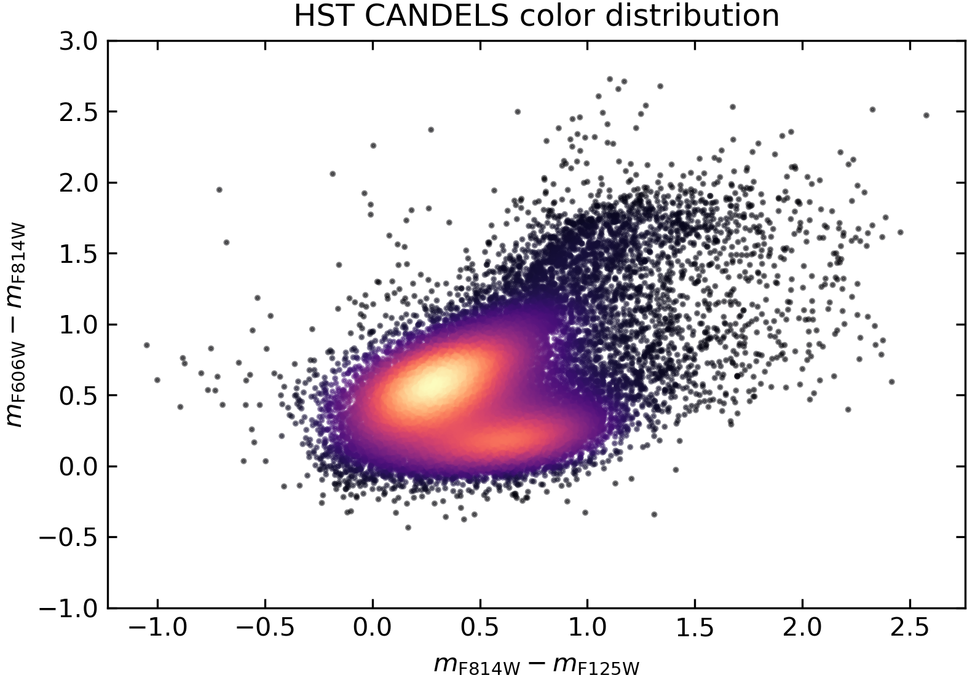
Topic 3: Determining the impact of visual+infrared galaxy morphology on color distributions with AI
The morphology of galaxies varies with wavelength -> this impacts how distributions of galaxy colors are measured, which has to be accurately simulated for next generation cosmological surveys.
Csizi et al. 2024 https://arxiv.org/pdf/2409.07528
In this project you will use a deep learning generative model to create simulated images of galaxies in multiple filter bands and measure their colors.
Requirements: some python experience, experience with AI and (extragalactic) astrophysics welcome
Source: B. Csizi

