Slide 1
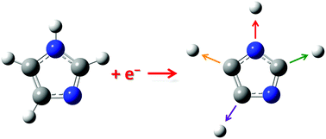
Institut für Ionenphysik und Angewandte Physik
Inelastic Electron Scattering – WG Denifl
Vy Nguyen

Slide 2
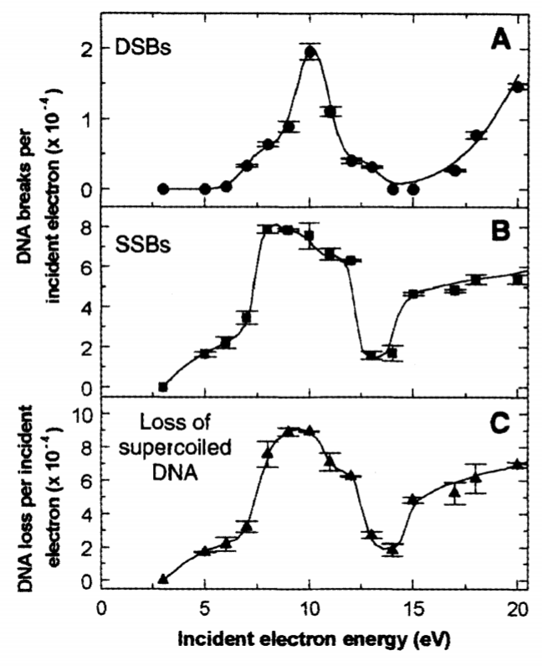
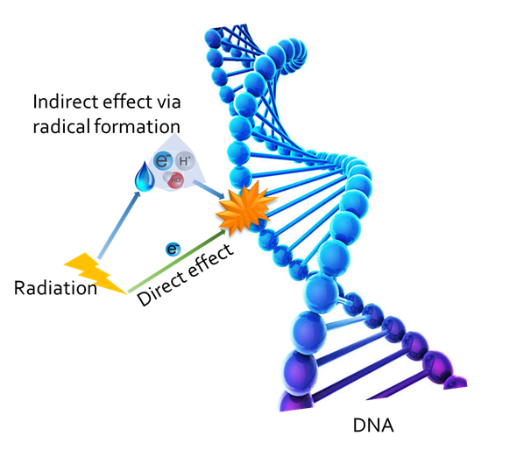
About the Inelastic Electron Scattering Group
The Group
Motivation
2 PhD Students and 2 student co-workers.
Chemical effect of radiation and low-energy electrons
Research fields
Single molecule studies
Low-energy electron (E_{kin}<100 eV) interaction with biomolecules, radiosensitisers and polymeric compounds
Clusters
Electron collisions with (heterogeneous) molecular clusters
B. Boudaïffa et al., (2000).
SSB – Single Strand Break
DSB – Double Strand Break
Applications
Radiation chemistry, astrochemistry, material sciences

Slide 3
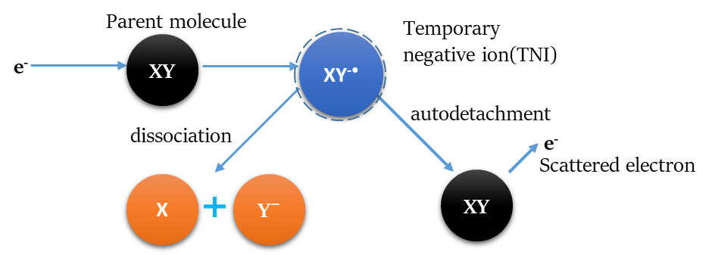
Electron Collisions
e⁻ + XY $→$ XY^{n+} + (n+1)e⁻
(multiple) ionisation
e⁻ + XY $→$ X⁺ + Y + 2e⁻
dissociative ionisation
neutral
fragment
fragment
anion
e⁻ + XY $→$ X⁺ + Y⁻ + e⁻
ion pair formation
e⁻ + XY $→$ XY^{-*} $→$ X + Y⁻
dissociative electron attachment
Results in bond cleavages:
Single bond, double bond or complex decompositions into multiple fragments

Slide 4
Experimental Setup
Crossed electron-molecular beam setup
Reflectron time-of-flight mass spectrometer

Slide 5
Possible topics in this year
Electron collisions to (heavy) water clusters
Electron collisions to the hydrated clusters of biologically relevant molecules

Slide 6
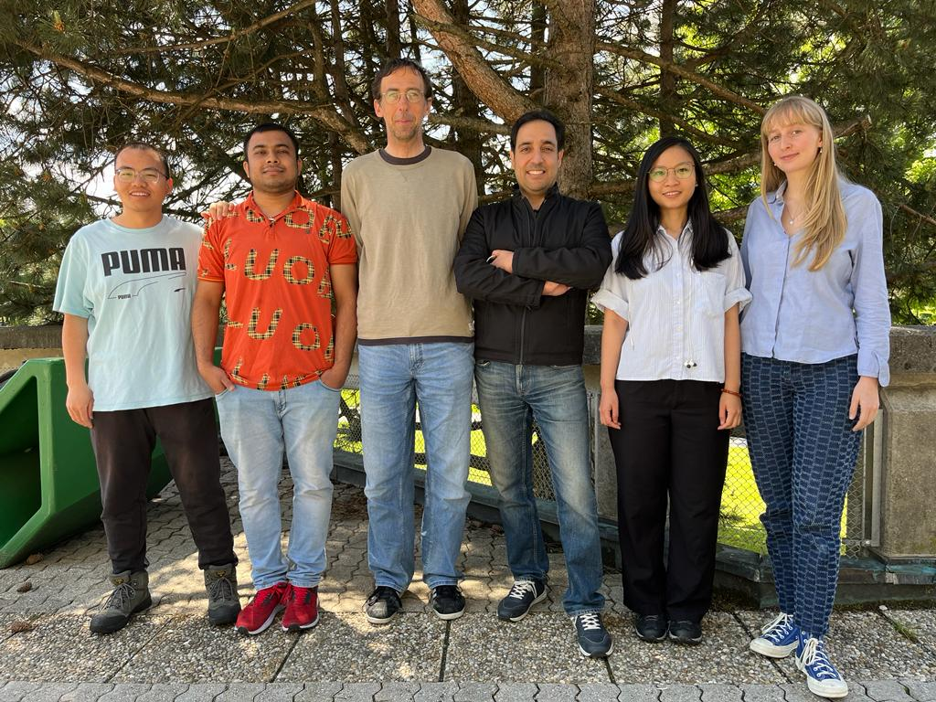
Acknowledgement
Thank you for your attention! For further information, please contact: Stephan.Denifl@uibk.ac.at

