Slide 1
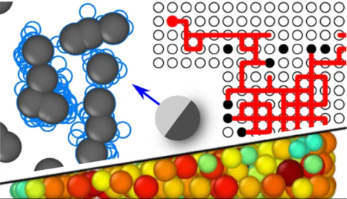
Theoretische Bio-Nano Physik
BioNano-Physics
Institut für Theoretische Physik
Universität Innsbruck
Prof. Thomas Franosch, Anton Lüders
16.01.2025

Slide 2
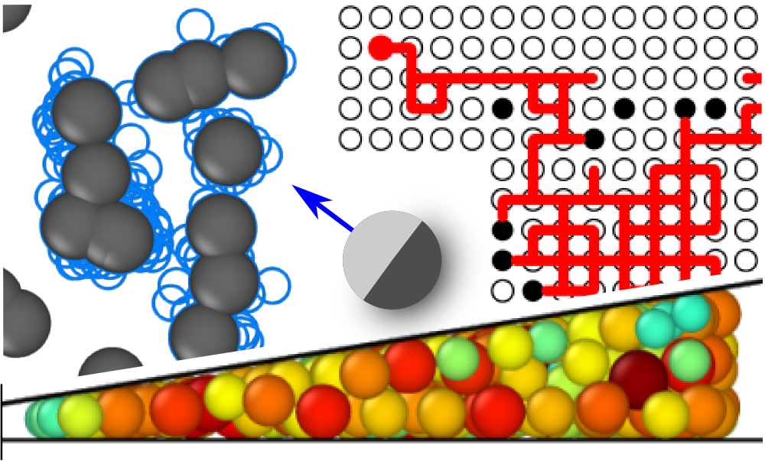
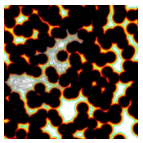
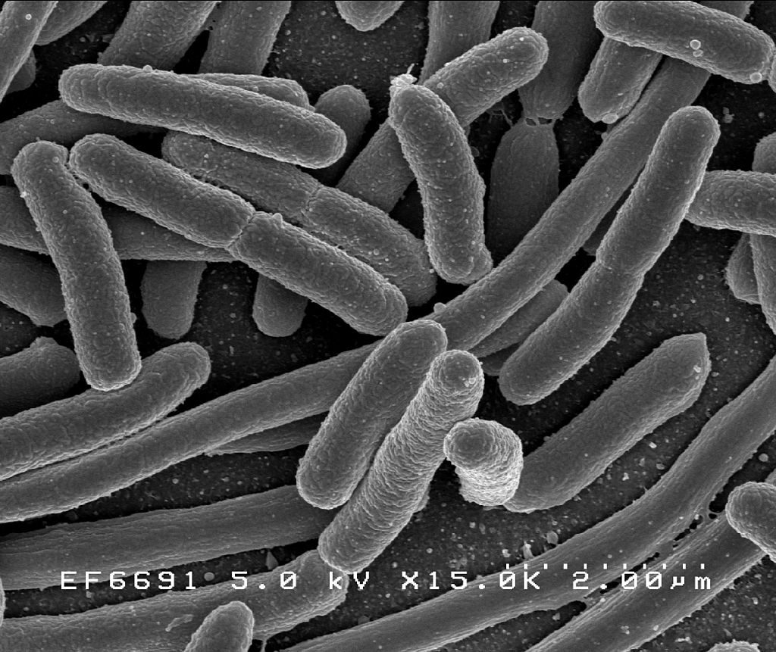
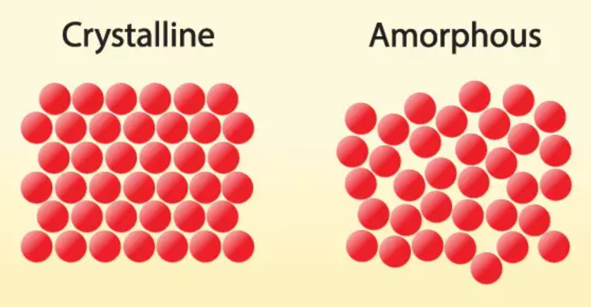
Statistical and soft matter physics
Complex
transport
Active
matter
https://de.wikipedia.org/wiki/Escherichia_coli
Glassy systems
https://futuretimeline.net/blog/2021/04/9-first-3d-atomic-imaging-amorphous-solid.htm
2/6

Slide 3
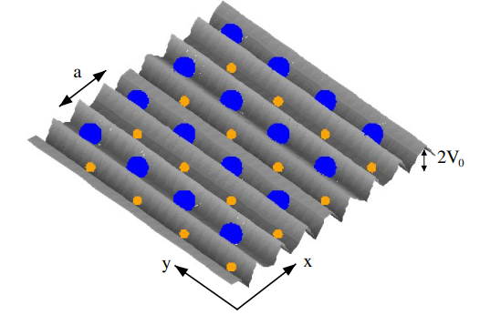
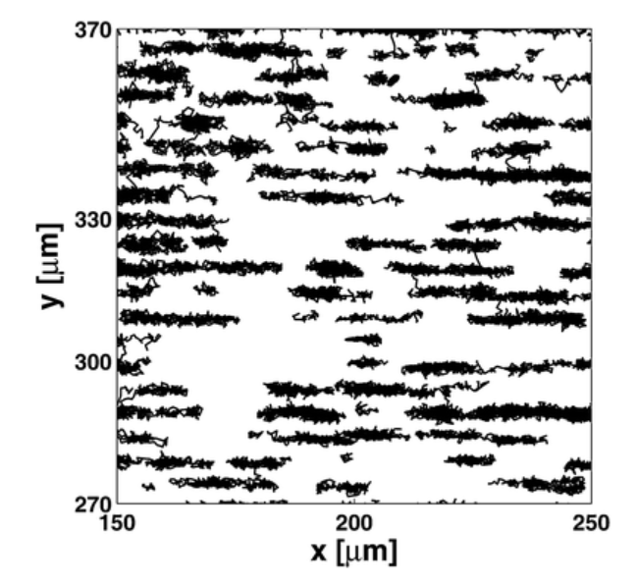
Brownian motion in periodic systems
Goal
Single colloid dynamics in periodic potentials: Obtaining and analyzing the probability density for displacements of fluctuating nano- and micro-particles in periodic potentials
Learning objectives
Getting familiar with colloidal systems (which can be found everywhere in our daily lives)
Depending on the interest of the student: Learn how to apply numerical tools, simulations, or analytic strategies to study colloids in external potentials
Calculating the probability density for a sinus potential with the chosen method
K. Franzrahe et al., J. Condens. Matter Phys.
40, 404218 (2008)
C. Dalle-Ferrier et al., Soft Matter 7, 2064 (2011)
C. Dalle-Ferrier et al., Soft Matter 7, 2064 (2011)
3/6

Slide 4
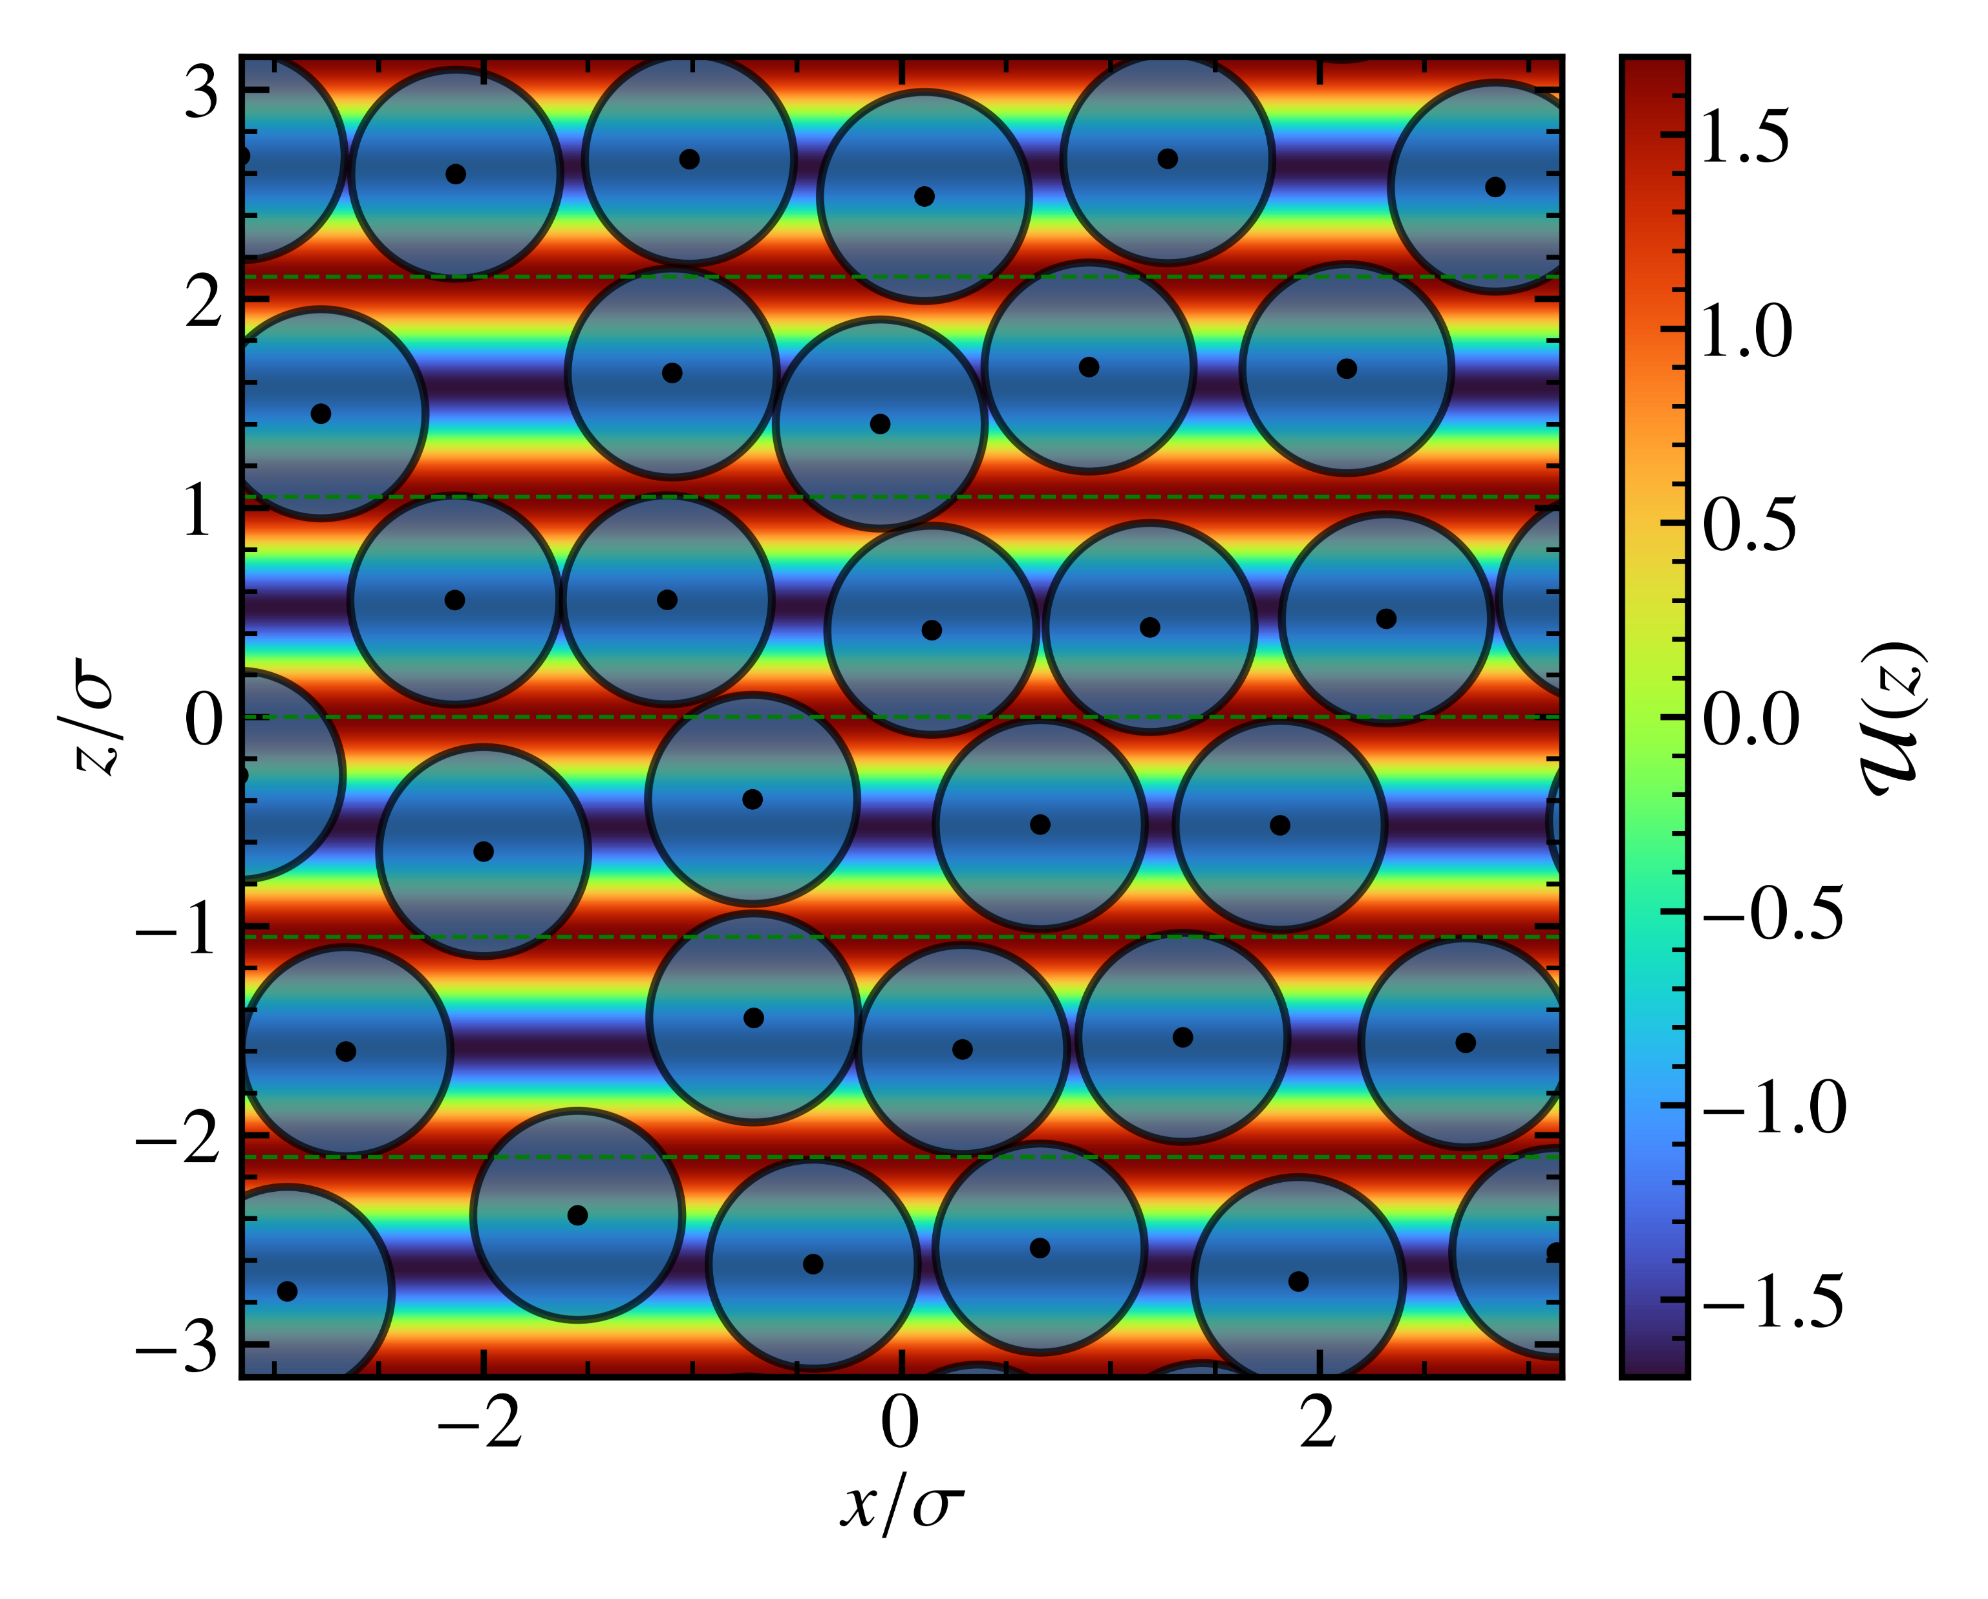
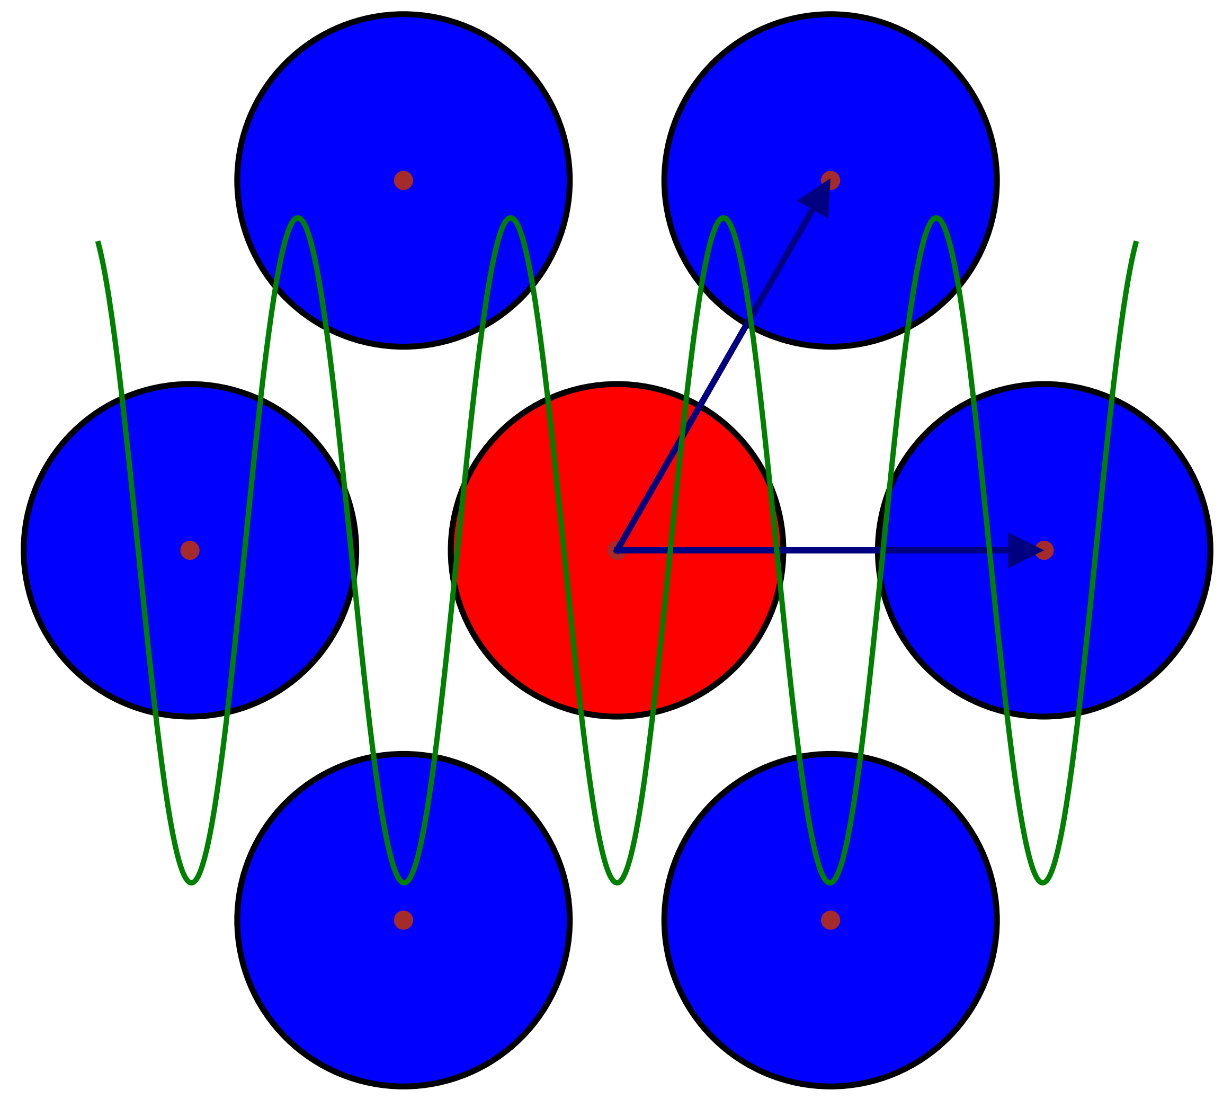
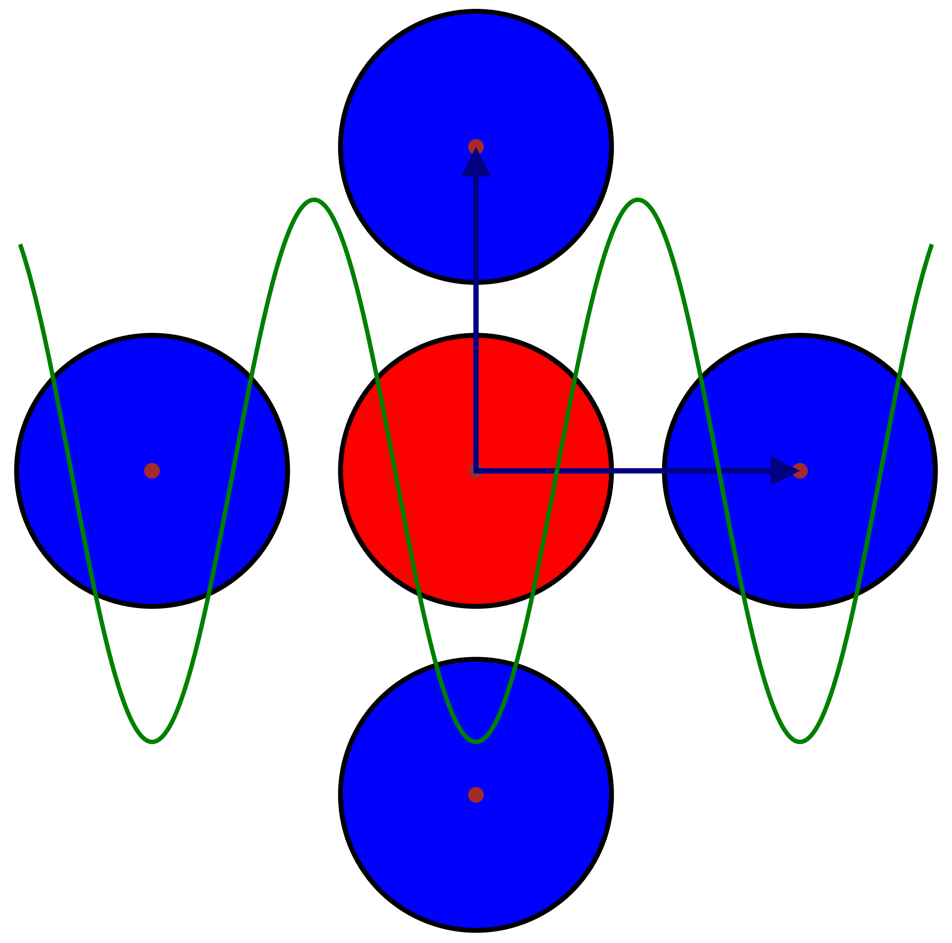
2D glass under external periodic modulation
Goal
Many-body structure formation in periodic potentials: Exploring the mechanism by which external fields influence the glass formation using Monte Carlo simulations of hard discs
Learning objectives
Understanding the fundamentals of the glass state
Learning how to perform Monte Carlo simulations of many-body systems (which have a wide range of applications in countless other fields)
Analyze how the modulation wavelength of an external potential affects the formation and order of particle cages that superpose the natural arrangement of hard discs
4/6

Slide 5
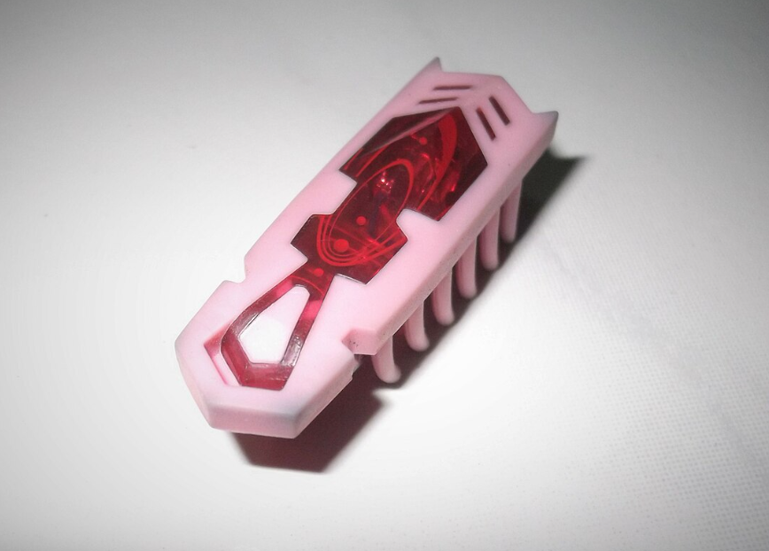
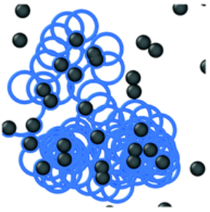
Hexbugs in crowded environments
Goal
Rod-shaped circle swimmers in random environments: Studying the influence of random obstacles on the dynamics of „hexbug-like“ active particles
Learning objectives
Getting familiar with simple models for active matter
Learning how to implement and perform Brownian dynamics simulations to obtain trajectories of active particles in many-body systems
Characterize and interpret the motion of rod-shaped active circle swimmers through randomly placed obstacles
https://en.wikipedia.org/wiki/Hexbug
O. Chepizhko et al., Soft Matter 15, 452 (2019)
5/6

Slide 6
Thank you for your attention!
BioNano-Physics
Potential Master theses are also
available in various topics
Glass transition
Active particles
Complex transport
Anton Lüders
anton.lueders@uibk.ac.at
BioNano-Physics
Institute for The­o­ret­i­cal Physics
University of Innsbruck
If you are interested,
please just approach us!

